Slide 1
Unit 5: Big Data Processing Concepts

Slide 2
Outline
Parallel Data Processing
Distributed Data Processing
Hadoop
Processing Workloads
Cluster
Processing in Batch Mode
Processing in Real-time Mode

Slide 3
Parallel Data Processing
Parallel data processing involves the simultaneous execution of multiple sub-tasks that collectively comprise a larger task.
The goal is to reduce the execution time by dividing a single larger task into multiple smaller tasks that run concurrently.
Although parallel data processing can be achieved through multiple networked machines, it is more typically achieved within the confines of a single machine with multiple processors or cores, as shown in the following Figure.

Slide 4
A task can be divided into three sub-tasks that are executed in parallel on three different processors within the same machine

Slide 5
Distributed Data Processing
Distributed data processing is closely related to parallel data processing in that the same principle of “divide-and-conquer” is applied.
However, distributed data processing is always achieved through physically separate machines that are networked together as a cluster.

Slide 6
An example of distributed data processing

Slide 7
Hadoop
Hadoop is an open-source framework for large-scale data storage and data processing that is compatible with commodity hardware.
The Hadoop framework has established itself as a de facto industry platform for contemporary Big Data solutions.
It can be used as an ETL engine or as an analytics engine for processing large amounts of structured, semistructured and unstructured data.
From an analysis perspective, Hadoop implements the MapReduce processing framework.

Slide 8
Hadoop is a versatile framework that provides both processing and storage capabilities

Slide 9
Processing Workloads
A processing workload in Big Data is defined as the amount and nature of data that is processed within a certain amount of time. Workloads are usually divided into two types:
• batch
• transactional

Slide 10
Batch
Batch processing, also known as offline processing, involves processing data in batches and usually imposes delays, which in turn results in high-latency responses.
Batch workloads typically involve large quantities of data with sequential read/writes and comprise of groups of read or write queries.

Slide 11
Queries can be complex and involve multiple joins. OLAP systems commonly process workloads in batches.
Strategic BI and analytics are batch-oriented as they are highly read-intensive tasks involving large volumes of data.

Slide 12
A batch workload can include grouped read/writes to INSERT, SELECT, UPDATE and DELETE

Slide 13
Transactional
Transactional processing is also known as online processing. Transactional workload processing follows an approach whereby data is processed interactively without delay, resulting in low-latency responses.
Transaction workloads involve small amounts of data with random reads and writes.

Slide 14
OLTP and operational systems, which are generally write-intensive, fall within this category.
Although these workloads contain a mix of read/write queries, they are generally more write-intensive than read-intensive.
Transactional workloads comprise random reads/writes that involve fewer joins than business intelligence and reporting workloads.
Given their online nature and operational significance to the enterprise, they require low-latency responses with a smaller data footprint

Slide 15
Transactional workloads have few joins and lower latency responses than batch workloads

Slide 16
Cluster
In the same manner that clusters provide necessary support to create horizontally scalable storage solutions, clusters also provides the mechanism to enable distributed data processing with linear scalability.
Since clusters are highly scalable, they provide an ideal environment for Big Data processing as large datasets can be divided into smaller datasets and then processed in parallel in a distributed manner.

Slide 17
An additional benefit of clusters is that they provide inherent redundancy and fault tolerance, as they consist of physically separate nodes.
Redundancy and fault tolerance allow resilient processing and analysis to occur if a network or node failure occurs.
Due to fluctuations in the processing demands placed upon a Big Data environment, leveraging cloud-host infrastructure services, or ready-made analytical environments as the backbone of a cluster, is sensible due to their elasticity and pay-for-use model of utility-based computing.

Slide 18
A cluster can be utilized to support batch processing of bulk data and realtime processing of streaming data

Slide 19
Processing in Batch Mode
In batch mode, data is processed offline in batches and the response time could vary from minutes to hours. As well, data must be persisted to the disk before it can be processed.
Batch mode generally involves processing a range of large datasets, either on their own or joined together, essentially addressing the volume and variety characteristics of Big Data datasets.

Slide 20
The majority of Big Data processing occurs in batch mode. It is relatively simple, easy to set up and low in cost compared to realtime mode.
Strategic BI, predictive and prescriptive analytics and ETL operations are commonly batch-oriented.

Slide 21
Batch Processing with MapReduce
MapReduce is a widely used implementation of a batch processing framework.
It is highly scalable and reliable and is based on the principle of divide-and-conquer, which provides built-in fault tolerance and redundancy.
It divides a big problem into a collection of smaller problems that can each be solved quickly.
MapReduce has roots in both distributed and parallel computing.
MapReduce is a batch-oriented processing engine used to process large datasets using parallel processing deployed over clusters of commodity hardware.

Slide 22
The symbol used to represent a processing engine
MapReduce does not require that the input data conform to any particular data model.
Therefore, it can be used to process schema-less datasets. A dataset is broken down into multiple smaller parts, and operations are performed on each part independently and in parallel.
The results from all operations are then summarized to arrive at the answer.
Because of the coordination overhead involved in managing a job, the MapReduce processing engine generally only supports batch workloads as this work is not expected to have low latency.
MapReduce is based on Google’s research paper on the subject, published in early 2000.

Slide 23
The MapReduce processing engine works differently compared to the traditional data processing paradigm.
Traditionally, data processing requires moving data from the storage node to the processing node that runs the data processing algorithm.
This approach works fine for smaller datasets; however, with large datasets, moving data can incur more overhead than the actual processing of the data.

Slide 24
With MapReduce, the data processing algorithm is instead moved to the nodes that store the data.
The data processing algorithm executes in parallel on these nodes, thereby eliminating the need to move the data first.
This not only saves network bandwidth but it also results in a large reduction in processing time for large datasets, since processing smaller chunks of data in parallel is much faster.

Slide 25
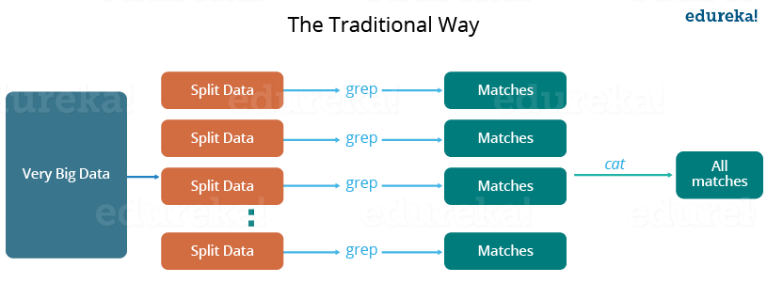

Slide 26
how parallel and distributed processing used to happen in a traditional way? So, let us take an example where I have a weather log containing the daily average temperature of the years from 2000 to 2015. Here, I want to calculate the day having the highest temperature each year.
So, just like in the traditional way, I will split the data into smaller parts or blocks and store them in different machines. Then, I will find the highest temperature in each part stored in the corresponding machine. At last, I will combine the results received from each of the machines to have the final output.

Slide 27
Let us look at the challenges associated with this traditional approach:
Critical path problem: It is the amount of time taken to finish the job without delaying the next milestone or actual completion date. So, if, any of the machines delay the job, the whole work gets delayed.
Reliability problem: What if, any of the machines which are working with a part of data fails? The management of this failover becomes a challenge.

Slide 28
Equal split issue: How will I divide the data into smaller chunks so that each machine gets even part of data to work with. In other words, how to equally divide the data such that no individual machine is overloaded or underutilized.
Single split may fail: If any of the machines fail to provide the output, I will not be able to calculate the result. So, there should be a mechanism to ensure this fault tolerance capability of the system.
Aggregation of the result: There should be a mechanism to aggregate the result generated by each of the machines to produce the final output.

Slide 29
To overcome these issues, we have the MapReduce framework which allows us to perform such parallel computations without bothering about the issues like reliability, fault tolerance etc. Therefore, MapReduce gives you the flexibility to write code logic without caring about the design issues of the system.

Slide 30
Map and Reduce Tasks
A single processing run of the MapReduce processing engine is known as a MapReduce job.
Each MapReduce job is composed of a map task and a reduce task and each task consists of multiple stages.
Map tasks
• map
• combine (optional)
• partition
Reduce tasks
• shuffle and sort
• reduce

Slide 31
Hadoop MapReduce Applications
Analysis of logs,
data analysis,
recommendation mechanisms,
fraud detection,
user behavior analysis,
genetic algorithms,
scheduling problems,
resource planning among others, is applications that use MapReduce.

Slide 32
Social Networks
We are social networking users like Facebook, Twitter, and LinkedIn to connect with our friends and community.
Many of the features, such as who visited your LinkedIn profile, who read your post on Facebook or Twitter, can be evaluated using the MapReduce, programming model.
Entertainment
Netflix uses Hadoop and MapReduce to solve problems such as discovering the most popular movies, based on what you watched, what do you like? Providing suggestions to registered users taken into account their interests.
MapReduce can determine how users are watching movies, analyzing their logs and clicks.

Slide 33
An illustration of a MapReduce job with the map stage highlighted

Slide 34
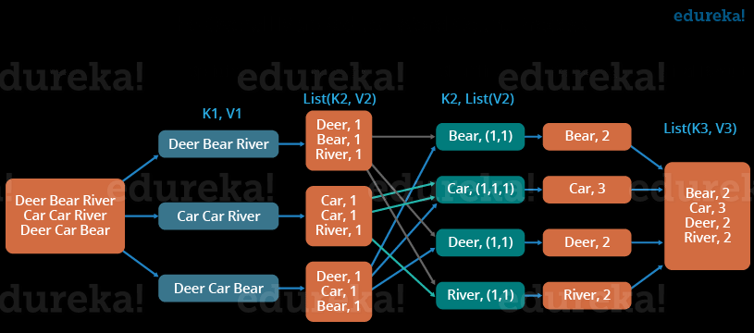

Slide 35
Map
The first stage of MapReduce is known as map, during which the dataset file is divided into multiple smaller splits.
Each split is parsed into its constituent records as a key-value pair. The key is usually the ordinal position of the record, and the value is the actual record.
The parsed key-value pairs for each split are then sent to a map function or mapper, with one mapper function per split. The map function executes user-defined logic.
Each split generally contains multiple key-value pairs, and the mapper is run once for each key-value pair in the split.

Slide 36
The mapper processes each key-value pair as per the user-defined logic and further generates a key-value pair as its output.
The output key can either be the same as the input key or a substring value from the input value, or another serializable user-defined object.
Serialization is the process of converting a data object—a combination of code and data represented within a region of data storage—into a series of bytes that saves the state of the object in an easily transmittable form.
Similarly, the output value can either be the same as the input value or a substring value from the input value, or another serializable user-defined object.

Slide 37
When all records of the split have been processed, the output is a list of key-value pairs where multiple key-value pairs can exist for the same key.
It should be noted that for an input key-value pair, a mapper may not produce any output key-value pair (filtering) or can generate multiple key-value pairs (demultiplexing.)

Slide 38
Combine
Generally, the output of the map function is handled directly by the reduce function.
However, map tasks and reduce tasks are mostly run over different nodes. This requires moving data between mappers and reducers. This data movement can consume a lot of valuable bandwidth and directly contributes to processing latency.

Slide 39
With larger datasets, the time taken to move the data between map and reduce stages can exceed the actual processing undertaken by the map and reduce tasks.
For this reason, the MapReduce engine provides an optional combine function (combiner) that summarizes a mapper’s output before it gets processed by the reducer.

Slide 40
The combine stage groups the output from the map stage

Slide 41
A combiner is essentially a reducer function that locally groups a mapper’s output on the same node as the mapper.
A reducer function can be used as a combiner function, or a custom user-defined function can be used.
The MapReduce engine combines all values for a given key from the mapper output, creating multiple key-value pairs as input to the combiner where the key is not repeated and the value exists as a list of all corresponding values for that key.
The combiner stage is only an optimization stage, and may therefore not even be called by the MapReduce engine.

Slide 42
For example, a combiner function will work for finding the largest or the smallest number, but will not work for finding the average of all numbers since it only works with a subset of the data.

Slide 43
Partition
During the partition stage, if more than one reducer is involved, a partitioner divides the output from the mapper or combiner (if specified and called by the MapReduce engine) into partitions between reducer instances. The number of partitions will equal the number of reducers.

Slide 44
The partition stage assigns output from the map task to reducers

Slide 45
Although each partition contains multiple key-value pairs, all records for a particular key are assigned to the same partition.
The MapReduce engine guarantees a random and fair distribution between reducers while making sure that all of the same keys across multiple mappers end up with the same reducer instance.
Depending on the nature of the job, certain reducers can sometimes receive a large number of key-value pairs compared to others. As a result of this uneven workload, some reducers will finish earlier than others.
Overall, this is less efficient and leads to longer job execution times than if the work was evenly split across reducers. This can be rectified by customizing the partitioning logic in order to guarantee a fair distribution of key-value pairs.

Slide 46
The partition function is the last stage of the map task. It returns the index of the reducer to which a particular partition should be sent.

Slide 47
The hadfs command put is used to
A - Copy files from local file system to HDFS.
B - Copy files or directories from local file system to HDFS.
C - Copy files from from HDFS to local filesystem.
D - Copy files or directories from HDFS to local filesystem.

Slide 48
Shuffle and Sort
During the first stage of the reduce task, output from all partitioners is copied across the network to the nodes running the reduce task. This is known as shuffling. The list based key-value output from each partitioner can contain the same key multiple times.
Next, the MapReduce engine automatically groups and sorts the key-value pairs according to the keys so that the output contains a sorted list of all input keys and their values with the same keys appearing together. The way in which keys are grouped and sorted can be customized.

Slide 49
This merge creates a single key-value pair per group, where key is the group key and the value is the list of all group values.

Slide 50
During the shuffle and sort stage, data is copied across the network to the reducer nodes and sorted by key

Slide 51
Which of the command to check if Hadoop is up and running is
Jsp
Jps
Hadoop-fs
None of the above

Slide 52
Reduce
Reduce is the final stage of the reduce task. Depending on the user-defined logic specified in the reduce function (reducer), the reducer will either further summarize its input or will emit the output without making any changes.
In either case, for each key-value pair that a reducer receives, the list of values stored in the value part of the pair is processed and another key-value pair is written out.

Slide 53
The output key can either be the same as the input key or a substring value from the input value, or another serializable user-defined object.
The output value can either be the same as the input value or a substring value from the input value, or another serializable userdefined object.
Note that just like the mapper, for the input key-value pair, a reducer may not produce any
output key-value pair (filtering) or can generate multiple key-value pairs (demultiplexing).
The output of the reducer, that is the key-value pairs, is then written out as a separate file —one file per reducer.

Slide 54
The reduce stage is the last stage of the reduce task

Slide 55
Which of the stores the data
Data node
Name Node
Master node
All of the above

Slide 56
HDFS works in a which fashion
master-slave
master-worker
worker/slave
None of the above

Slide 57
___________ is general-purpose computing model and runtime system for distributed data analytics.
A. Mapreduce
B. Drill
C. Oozie
D. None of the mentioned

Slide 58
The need for data replication can arise in various scenarios like :
A. Replication Factor is changed
B. DataNode goes down
C. Data Blocks get corrupted
D. All of the mentioned

Slide 59
Reducer is input the grouped output of a :
A. Mapper
B. Reducer
C. Writable
D. Readable

Slide 60
The number of reducers can be customized. It is also possible to have a MapReduce job without a reducer, for example when performing filtering.
Note that the output signature (key-value types) of the map function should match that of the input signature (key-value types) of the reduce/combine function.

Slide 61
A Simple MapReduce Example
MapReduce steps are following
1. The input (sales.txt) is divided into two splits.
2. Two map tasks running on two different nodes, Node A and Node B, extract product and quantity from the respective split’s records in parallel. The output from each map function is a key-value pair where product is the key while quantity is the value.
3. The combiner then performs local summation of product quantities.

Slide 62
4. As there is only one reduce task, no partitioning is performed.
5. The output from the two map tasks is then copied to a third node, Node C, that runs the shuffle stage as part of the reduce task.
6. The sort stage then groups all quantities of the same product together as a list.
7. Like the combiner, the reduce function then sums up the quantities of each unique product in order to create the output.

Slide 63
An example of MapReduce in action

